Slide 1



Accounting Sustainability: A Cloud-Based Solution
Greetings, everyone! Today we focus on the critical role Accountants play in achieving sustainability goals and discuss a possible solution to their unique challenges.
by Emmanuel Akumefula

Slide 2

Challenges Faced by Accountants
1
Energy-intensive operations
2
Paper Consumption
The nature of accounting work requires significant energy consumption, including computer equipment and air conditioning.
Accountants rely heavily on physical documents and paper-based workflows, resulting in an excessive carbon footprint.
3
Limited Awareness
Sustainability is a relatively new concept in accounting and tax practice, and many accountants lack the knowledge and training to offer environmentally friendly alternatives.

Slide 3
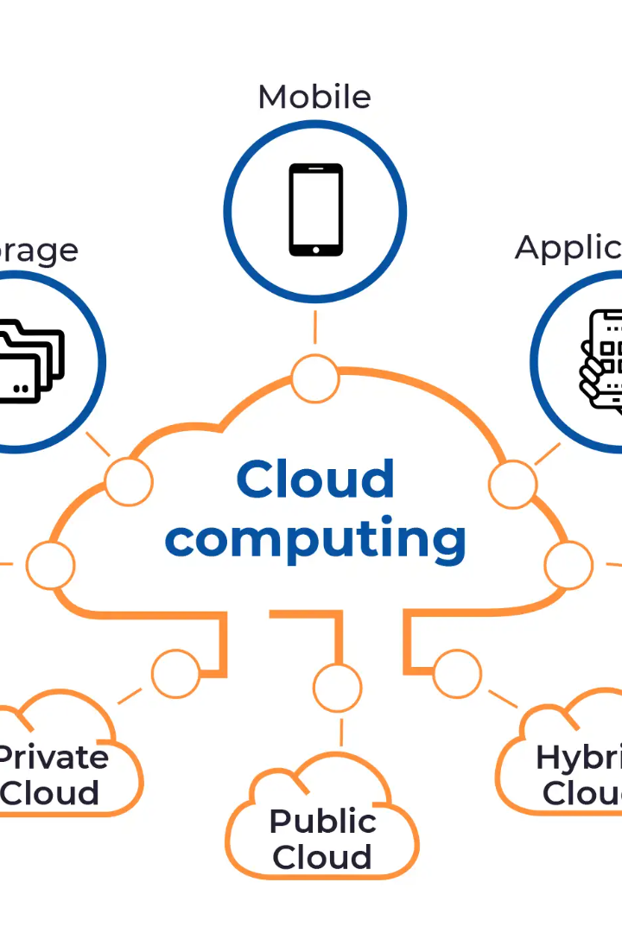
The Solution: Cloud-Based Accounting Software
This innovative program is designed to empower Accountants to track and analyse their energy usage and paper consumption, while also offering eco-friendly alternatives for their clients. By integrating sustainability modules, we are able to help our users make informed decisions about their environmental impact, all while streamlining their accounting processes. We believe this is a game-changing solution for the industry and are excited to see the positive impact it will have on our clients and the planet.

Slide 4
Advantages of Cloud-Based Solution
Cost-Effective & Accessible
Scalable & Customizable
Eco-friendly & Energy-efficient
Our software solution is a game-changer for Accountants who want to stay on top of their data, no matter where they are. With our cost-effective and efficient system, you can access real-time data from anywhere, without the need for on-premise accounting systems. Plus, our software is easy to use and intuitive, so you can focus on what really matters: your clients. Say goodbye to the hassle of traditional accounting systems and hello to a more streamlined way of working.
The cloud-based software is highly customizable to meet the unique needs of Accountants and their clients. As their business grows, they can upgrade the software to fit their requirements.
Our solution helps Accountants reduce their carbon footprint by using renewable energy to power the servers. Our software eliminates the need for physical documents, reducing paper consumption significantly.

Slide 5

Innovations: AI-driven Algorithms
Our software uses advanced AI algorithms to identify eco-friendly practices and provide data-driven insights. By comparing the energy usage and carbon footprint of different suppliers and manufacturers, Accountants can make informed decisions and recommend sustainable practices to their clients.

Slide 6

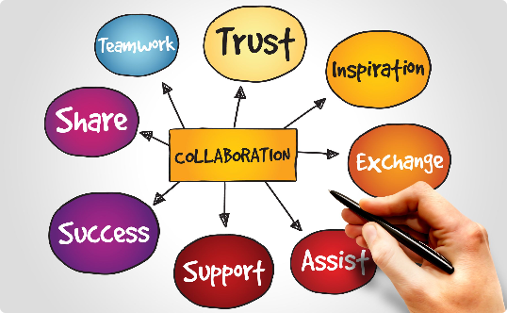

Seamless Integration and User-Friendly
Easy Integration
User-Friendly Design
Mobile Compatibility
Our cloud-based accounting software seamlessly integrates into existing accounting processes, ensuring easy adoption across the sector.
Our software features a straightforward, user-friendly design, which encourages widespread adoption and collaboration with team members and clients.
Accountants can access our software from any device, including smartphones and tablets, allowing them to work remotely and stay connected with their clients.

Slide 7
Feasibility and Scaling
Feasibility
Scalability
Our cloud-based accounting software is a feasible solution, offering cost savings, increased collaboration, and seamless integration, promoting eco-friendly practices.
Our software can scale up to meet the growing needs of Accountants and their clients. It can adapt to their unique accounting and tax requirements, ensuring they always have the tools they need to provide excellent service.

Slide 8

Conclusion
In conclusion, our cloud-based accounting software offers a cost-effective, scalable, and eco-friendly solution for Accountants to achieve Net Zero Carbon Emissions. With data-driven insights and real-time access to inventory and exceptional features, Accountants can lead the charge for a more sustainable future.

Slide 9

Interactive Q&A Session
Now, we invite you to share your thoughts and pose any questions about our proposed solution. Your feedback will help us refine our approach for a greener future.

